Slide 1
DevOps Proposition
http://capgemini.github.io/devops/apollo/

Slide 2
Agenda
Being on the Same Page
What we want to achieve..
What Industry is Talking About…Break the Wall…!!
Capgemini DevOps Blueprint
DevOps Automation View & Recommended Technology View
Different Speeds of DevOps Possible
What Speed is Right for an Enterprise?
DevOps Opportunities View
Case Studies
Capgemini DevOps Services
Appendix

Slide 3
Lets be on the same page…

Slide 4
What we want to achieve..
Goal
Time to Market
Quality
Production costs

Slide 5
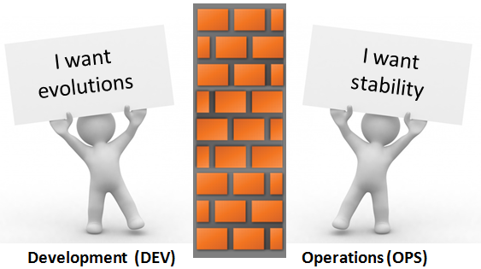


What Industry is Talking About…Break the Wall…!!
My job is to say « NO »
DevOps = Break the wall !
SCRUM
Development
Operations
QA
Agile Methods
DEVOPS
Business
DEV
OPS
XP
DevOps

Slide 6
“NextGen Delivery Model”
Goal
Time to Market
Quality
Production costs
Strategy
Organization & Culture
Architecture
Agile/Lean
Automation
Platform
Cross-Functional Teams
Freedom and Responsibility
Reward solution simplicity and reliability
Design Studio
Micro services
12 Factor
API Driven
Agile Framework
TDD & BDD
Common Business KPIs
Cont. Design
Cont. integration
Cont. Delivery
Cont. Testing
Cont. Monitoring
Self Service Catalogue
PAAS
Solution Components
Performance Measures
Deployment Frequency
Mean Time Between Deployments
Mean Time to Recover (MTTR)
Governed By
Delivery Command Center (DCC)

Slide 7

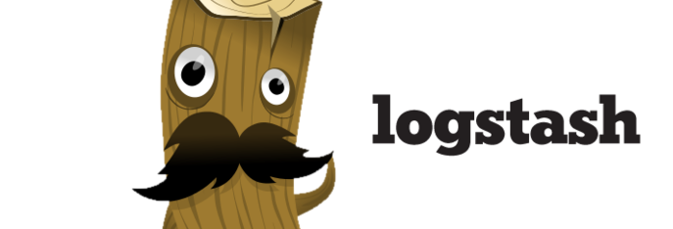
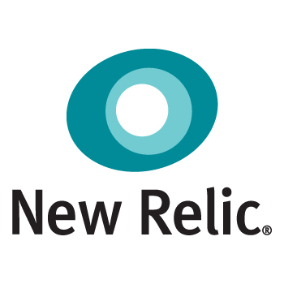

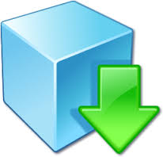





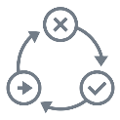


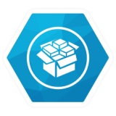



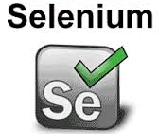




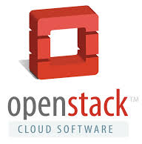




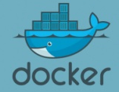

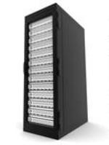





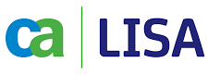




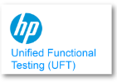
DevOps Automation View
Recommended Technology View
Monitoring & Control
SignOff
Deployable Software
Production Environment
Compile
Unit Test
Static Analysis
Packaging
Deployable Software
Compile
Unit Test
Static Analysis
Packaging
Commit Stage
Commit Stage
Load Testing
Load Testing
Source Code Repository
Environment Provisioning
Source Code Repository
Environment Provisioning
Development & Configuration
Development & Configuration
Perf Testing
Perf Testing
Release Stage
System of Records – Service Virtualization
Release Stage
System of Records – Service Virtualization
IDE’s – Eclipse, etc
Client / Prod. Owner
Project / Task Management
Project / Task Management
Ready to release Software
Acceptance Test
Ready to release Software
Acceptance Test
SignOff
SignOff
Acceptance Stage
Acceptance Stage
Load + Perf Stage
Load + Perf Stage

Slide 8

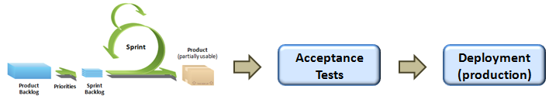




Implementation Flow
Continuous Integration
Continuous
Delivery
Continuous
Deployment

Slide 9
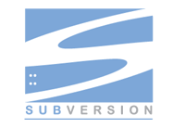







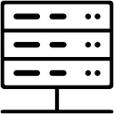




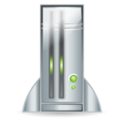
Container based CI and CD
Gap between Dev build and Ops build
Scripts
Zip, WAR, JAR …
VCS
CI
Ops
Dev
DEX, PTI …
QA
Production
Dev
Technical Test
Performances

Slide 10
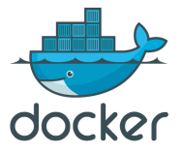

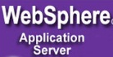
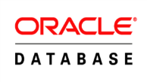
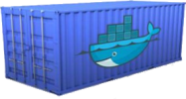
Container based CI and CD
how integrated tools can help (Docker as example)
Image V1
Image V1
Zip, WAR, JAR …
Image V2
VCS
Scripts
Private Registry Docker
Dev
QA
Ops
Training
Prod
Dev
Continuous Delivery Platform
Perf

Slide 11

Continuous Deployment Demo
Live Demo

Slide 12
Achieving the right speed and agility for each application and service depends on the workload
 | Slow | Fast | Faster | Fastest
Customer facing applications
Supporting services
Enterprise integration and middleware
Systems of records
Legacy systems
The “right” speed will depend on the organization, business strategy, and application landscape
Notes:
This slide shows indicatively where components of an application architecture might evolve to. Some systems by nature will stay slower but their interface into the more modern architecture will change. Think APIs, application gateways, service orientation, and obfuscation layers.

Slide 13
Minimum Viable Transformation that can be initiated immediately
Development
Testing
Infrastructure
Trunk based Development
Automated Unit Tests > 70%
Automated Unit Integration Tests > 70%
Technical Debt ( X% of effort expended till date)
Continuous Integration with mandatorily nightly build
TDD / BDD (Dev)
Single PM and Defect Management tool
MicroService Architecture
12 Factor Application Principles
Automates Functional Testing > 70%
Automated Performance & regression Testing > 70%
Service Virtualization > 85%
Automated Accessibility Testing >= 25%
Automated Cross-browser Testing > 70%
Self Service Environment Provisioning Portal (70% for all dev and test environments)
Immutable Infrastructure enabled through PaaS
Blue / Green Environment
Chaos Monkey Sessions
Continuous Monitoring of all environments

Slide 14
DevOps Opportunities View
Build Automation
Content Management
Version Control
Continuous Integration
Unit Test Automation
UI-based Test Automation
Test Data Management
Packaged Repository
Automated Functional Testing
Service Virtualization
Continuous Delivery
Environment Management
Static Analysis
Next-Gen Architecture
Life-cycle Integration
Automated Environment Provisioning
Release Automation
Application Analytics
API based Services
Containerization
Already Practiced
Can be taken immediately
Realized Overtime

Slide 15
Case Studies

Slide 16
DevOps for a a Major Financial Institution
1
Highlights
High awareness of DevOps “movement” and its potential value
Experimentation of DevOps through use of tools like SVN, Jenkins, Bamboo and others are occurring at many areas
Opportunities
Different interpretation of DevOps
No shared vision of DevOps; limited team collaboration among key stakeholders
All workloads can significantly benefit from DevOps and achieve “Fast” speed; digital and front-end workloads with Agile can go to even “Faster” speed
Although each workload may have different pain points and desired DevOps capabilities and state, there needs to be common DevOps capabilities especially around deployments, release management, and environments
Also as each workload embarks on DevOps journey, it needs to be treated as a “transformational initiative” starting with:
Involvement of all stakeholders: business, dev, test, platform services, TSM
Alignment on key business drivers, objectives, and desired outcomes (e.g. Increase on-time delivery and quality by X% versus just agreeing to do DevOps)
Focus on culture and process FIRST; then automation

Slide 17
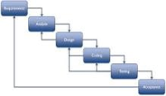
Viable DevOps Enabled - Waterfall Scenario
1
Common code repository using SVN, GIT or Artifactory
Basic build automation to include automated unit, regression testing with Jenkins or Bamboo
Higher degree of testing automation from ST to QA
Stage 1
Speed up serial execution
Reqts
Dev
UT
ST
SIT
UAT
PVT
QA
Prod
“One” environment team (virtual and/or delegated)
Basic build automation: server configuration with* Puppet or Chef, and deployment using* Jenkins or Bamboo
Operational monitoring visibility*
Enable parallel tracks of development and use common code base
More upstream integration testing with service virtualization-enabled ST (using CA Lisa) of back-end or middleware integrations
Stage 2
Accelerate further with independent, potentially parallel, development and testing tracks
Dev
UT
ST
Reqts
Dev
UT
ST
Reg
SIT
UAT
PVT
QA
Prod
Dev
UT
ST
Each successful build and ST updates common code base
Repository to expand and include build packages using (a)
Automated release management for deployments using HP Codar, Jenkins or Bamboo

Slide 18
Recommended DevOps Enabled Agile Scenario
1
Continuous Sprints
Scheduled Deploy Trains
Enabling continuous integration, delivery, to “deployment”
Dsgn
Dev
UT
ST
SEC
Dev
UT
ST
Snapshot
Dsgn
3
Sprint
Planning
1
REG
BVT
Dsgn
Dev
UT
ST
2
3
BATCH
Dsgn
Dev
UT
ST
PVT
Involve operations in sprints
Enhanced UT (JUnit, code analyzers)
Continuous integration (Bamboo) with parallel STs using service virtualization (CA Lisa) and emulators (mobile)
Common artifact repository (source code, build) using Artifactory
Transform middleware and integrations into micro services and put in cloud for Dev & Test environments
Continuous delivery enabled by Pivotal Cloud Foundry and HP Codar, which orchestrates builds, deployments and use of integration services in conjunction with other tools in prior slide
Deployment feedback through Mobile*: HockeyApp, Appaloosa, TestFairy, Play Store, Apphanc
Builds
Snapshot
Common Svcs
Banking
Super
M & I
1
2
3
3
1
2
3
1
1
2
3
2
1
2
3
3

Slide 19
DevOps Transformation for a Large European Bank
2
Waterfall approach – upfront requirements, double testing
Started adopting Agile (Scrum) methodology
Picking up Continuous Delivery. Tools knowledge imparted
Development and Operations Working as One Team
DevOps Delivery
Initial Scenario
Waterfall based Development by Capgemini
Client was owning the testing and operations
Typical Issues faced :
High Governance Costs
Long preparation time for projects
Many Handovers
Unstable Teams
Capgemini’s Solution / Approach
Capgemini provided DevOps Consulting services to adopt DevOps principles in a phased manner
As a first step, team members from both, Client and Capgemini received coaching on Scrum and there was increased access to the development environments for both.
Team fully adopted scrum principles of agile methodology
Then teams started picking up on continuous delivery. Rigorous training programs and tool deployment was carried out
Slowly, all other barriers were removed, Teams were co-located and full adoption of DevOps was achieved.
Results
Time to market decreased
Very efficient test process
No time lost in change processes
Stable Operations
Lots of automated tests
Team that builds an application will also maintain it
Business involvement increased
Priorities are clear (make the right things)
Early feedback
Clear Responsibilities

Slide 20




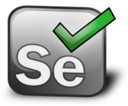



Tools Used
2
Continuous Deployment
Agile Project Management
Requirements Management
Automated Testing
Repository
Performance Testing
Test Driven Development
Static Code Analysis
Continuous Integration
Monitoring
Logstash
Jenkins

Slide 21
Capgemini DevOps Services

Slide 22







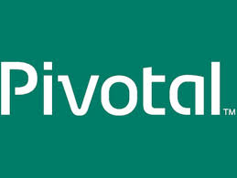


We are the Thought Leaders & have Global DevOps Capabilities
Strong Global Capabilities – 2000+ Professionals
DevOps Transformation and Delivery for Major Clients
A major European Bank
A government supported Environment Agency
A large global Insurance provider
A large Australian Bank
A multinational Energy Company
Service Offerings
Alliance Partnerships
Consultancy
Labs
Center of Excellences
Professional Services

Slide 23
Capgemini DevOps Service Offerings imparts higher Business Value
Consultancy
Labs
CoEs
Professional Services
Strategizing
Research
Build & Continuous Integration
Build Engineers
Assessment
Continuous Integration on Cloud
Configuration & Environment Management
Continuous Integration Engineers
Designing
Continuous Delivery on Cloud
Automation Testing
DevOps Consultant
Operations Transformation
People | Process | Technology
Dev, Test, Pre-prod on cloud
Monitoring & Measurement
SysAdmin
Technology Consulting
Configuration Management Cookbook & blueprint
Cloud
Architects
App Lifecycle data analytics
Agile / LEAN
Release Managers
DevOps Pipeline on Cloud
Program Managers
DevOps Transformation Engagement Model comprising Consultancy, Lab and CoEs
Engagement Models
Fix Duration Fix Price
Pay per use
Managed Services
T&M

Slide 24
Appendix

Slide 25
DevOps Automation Maturity Curve
Basic
Emerging
Coordinated
Enhanced
Top Level
Environment Build using SCM
Continuous Deployment
Automated Tool based Monitoring & Control
Behavior Driven Development (Lot of manual Processes)
Test Automation
Unit Test Automation
Test Data Management
Service Virtualization
Tool Based Configuration Management
Manual Test Practices
Tool based Defect Management
Continuous Integration
Automated Environment Provisioning
Manual Build & Deploy
Agile / Iterative Builds
Tool bases Requirement Traceability
Basic Source Code Management

